Slide 1

General Meeting 12.01.2023

Slide 2
Status
File structures
ML Architectures
Data treatment
Writing
Whenever the data is done, It’s possible to produce results

Slide 3
DATa issues
Depth correlation
Vertical «noise»

Slide 4
Open source datasets
SEAM dataset
Used for modeling salt body petroleum reservoirs
Will have to model the seismic..
Just convolve the wavelet?
More sophisticated modeling?

Slide 5
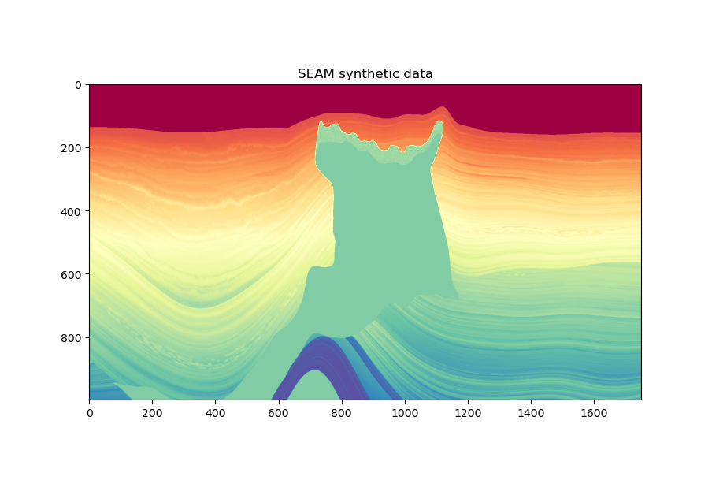

Slide 6
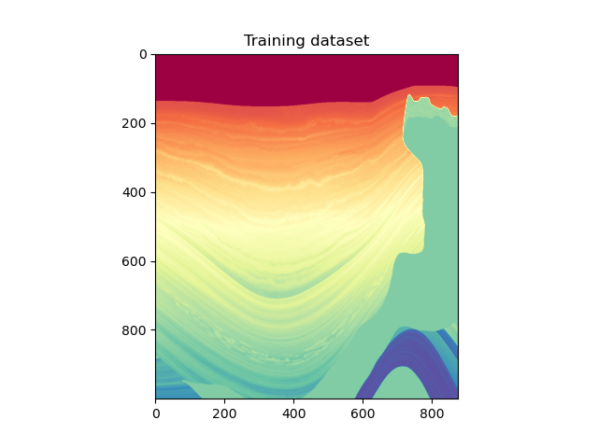
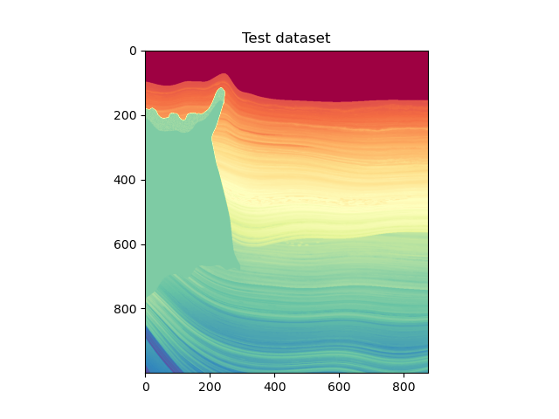

Slide 7
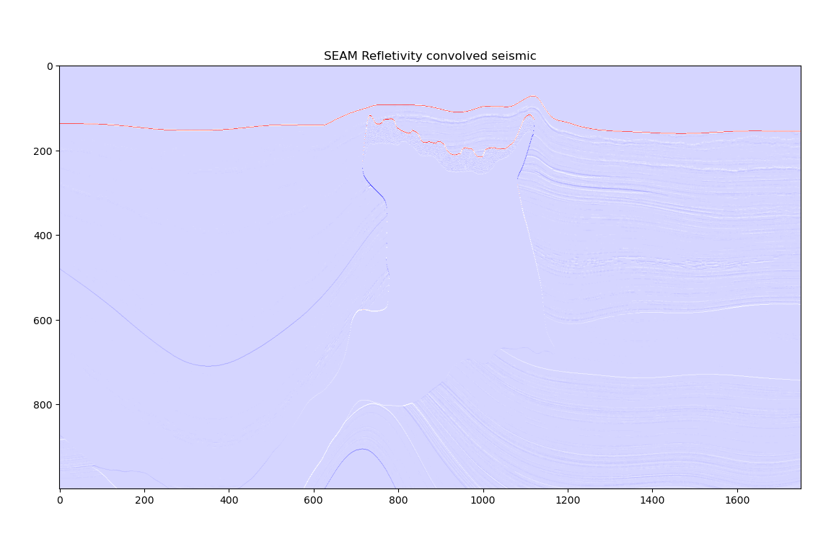

Slide 8
writing
For ML I’m using Tom Mitchell’s book «Machine Learning»
Also other sources from papers.

